Slide 1
CAMERA TRANSITIONS Personal Research – Project II
Roger Pérez Romera
CITM UPC Terrassa

Slide 2
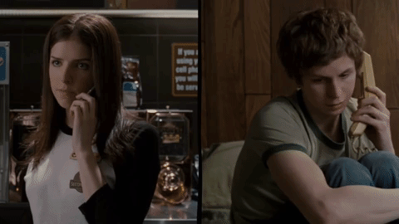
Theory: - What is a transition? - Types of transitions - Use of transitions Code: - - -
Scott Pilgrim vs The World

Slide 3
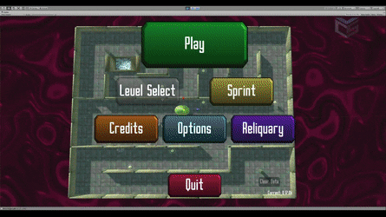
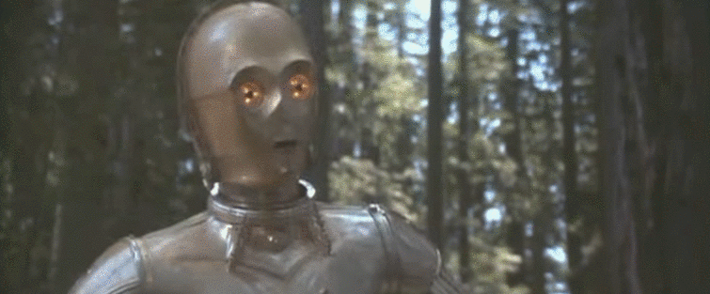
Theory – What is a transition?
Effect between a scene and the next one.
Create and produce an effect to the spectator.
Films, videogames, series…
Cinematic moments vs. menus and UI.
Star Wars
Sky Labyrinth

Slide 4
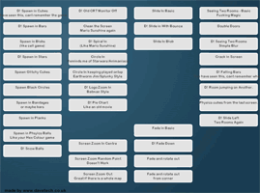
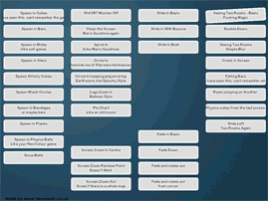
Theory - Types of transitions
Fade:
Slow
Tension
Importance
Cross - Fade:
Faster
Simple
Non-Aggressive

Slide 5
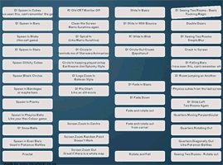
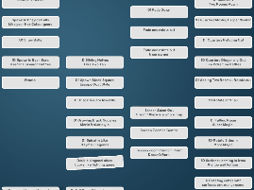
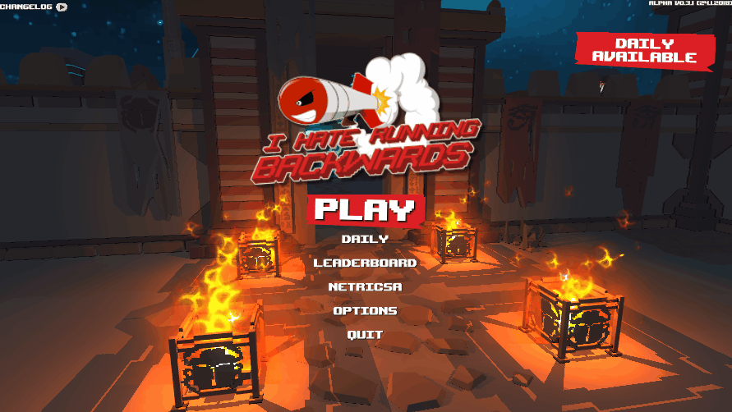
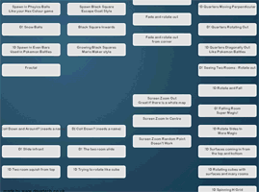
Theory - Types of transitions
Wipe:
Freedom
Emotional charge
Pan and Zoom:
Powerful
Dynamism
Action
I Hate Running Backwards

Slide 6
Theory - Use of transitions
The transitions you choose are important!
But for the game… transitions will give us time to:
Load a scene or level.
Keep the player immersed.
So we will do the change of scene during the transition.
Use the next links to get creative on your scenes transitions:
http://www.davetech.co.uk/screentransitions
https://www.youtube.com/watch?v=fKgvno6k-og

